Slide 1
What is normalization?
the practice of optimizing table structures

Slide 2
What is normalization?
technique for designing relational database tables to minimize duplication of information and, in so doing, to safeguard the database against certain types of logical or structural problems

Slide 3
Why normalization?
to remove data redundancy
to remove anomalies

Slide 4
An Unnormalized Relation
Plot No. | Street | Area (sq ft.) | Price (lacs) | Tax (Rs.) | Owner’s SSN | Owner’s Name
12 | Swinho Street | 720 | 15 | 1,990 | A394 | ABC
15 | Netaji Sarani | 560 | 12 | 1,750 | D791 | DEF
 | D. H. Road | 890 | 19 | 1,830 | J195 | JKL
17 | D. H. Road | 560 | 12 | 1,830 | X572 | XYZ
 | Netaji Sarani | 890 | 19 | 1,750 | A394 | ABC
 | Marx Sarani | 720 | 15 | 1,670 | J195 | JKL
23 | Marx Sarani | 560 | 12 | 1,670 | X572 | XYZ

Slide 5
Normal forms
The Normal Forms are a series of guidelines for ensuring that databases are normalized

Slide 6
Atomic Attributes
A attribute is atomic if domains of the attribute are considered to be indivisible.

Slide 7
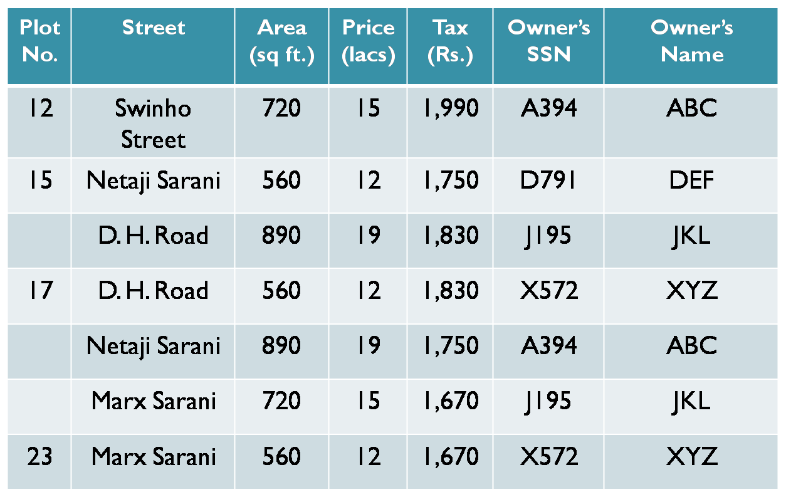
Some Non-atomic Attributes

Slide 8
First Normal Form (1NF)
Domains of all attributes must be atomic.

Slide 9
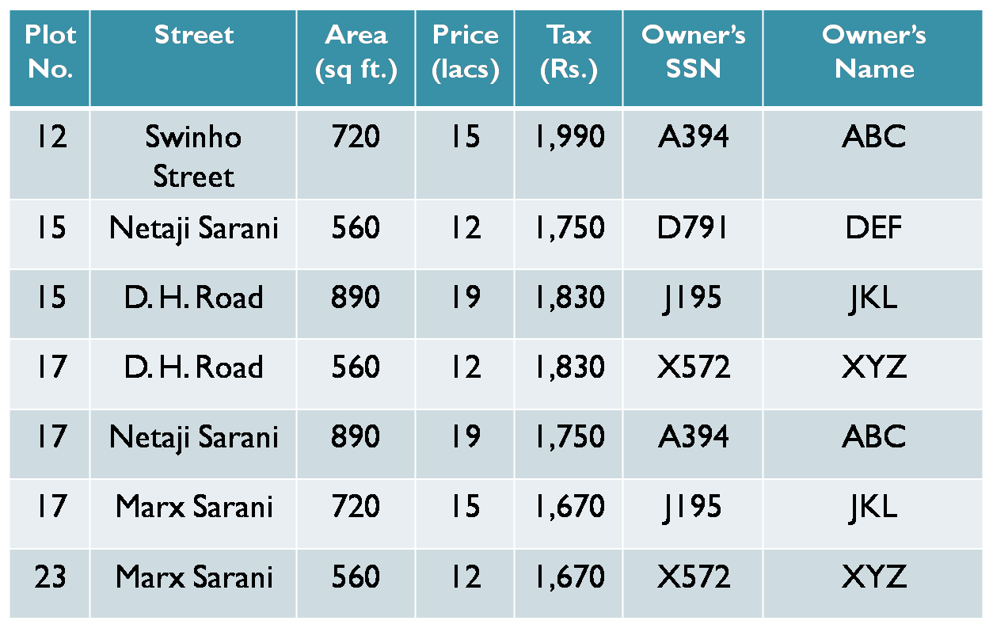
Relation in 1NF

Slide 10
Functional Dependencies
Let R be a relation schema
α ⊆ R and β ⊆ R
The functional dependency
α → β
holds on R if and only if for any legal relations r(R), whenever any two tuples t₁ and t₂ of r agree on the attributes α, they also agree on the attributes β. That is,
t₁[α] = t₂ [α] ⇒ t₁[β ] = t₂ [β ]
Example: Consider r(A,B ) with the following instance of r.
On this instance, A → B does NOT hold, but B → A does hold.
4
1 5
3 7

Slide 11
Partial Dependency
when a non-key attribute depends on a part of the candidate key rather than the whole candidate key then the non key attribute is partially dependent on the candidate key.

Slide 12
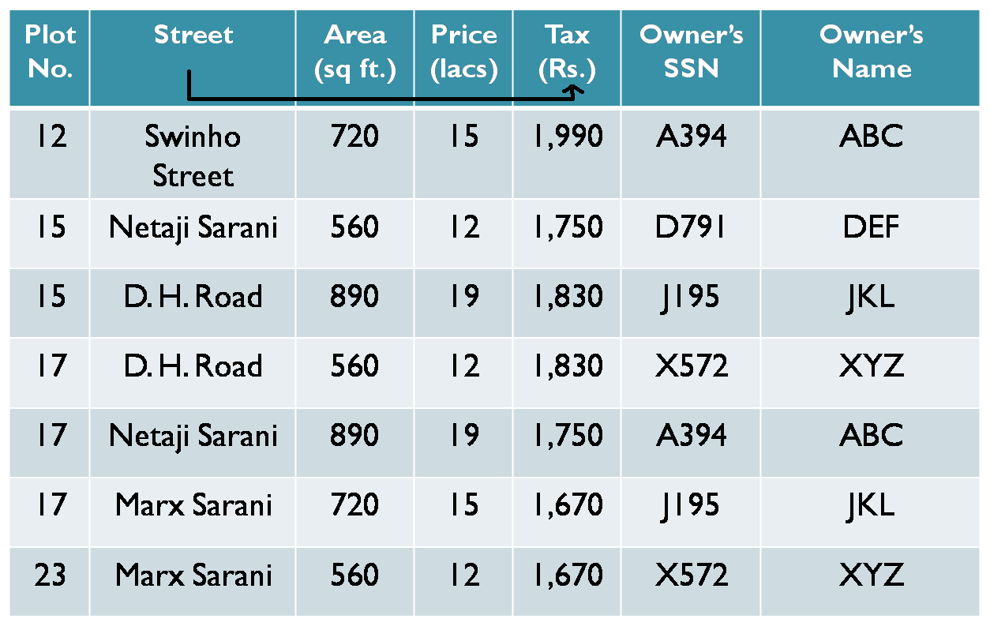
Example of Partial Dependency

Slide 13
Functional Dependencies
Constraints on the set of legal relations.
Require that the value for a certain set of attributes determines uniquely the value for another set of attributes.
A functional dependency is a generalization of the notion of a key.

Slide 14
Second Normal Form (2NF)
It must be in 1NF.
It must not contain any partial dependency.

Slide 15
Relation in 2NF
Plot No. | Street | Area (sq ft.) | Price (lacs) | Owner’s SSN | Owner’s Name
12 | Swinho Street | 720 | 15 | A394 | ABC
15 | Netaji Sarani | 560 | 12 | D791 | DEF
15 | D, H. Road | 890 | 19 | J195 | JKL
17 | D. H. Road | 560 | 12 | X572 | XYZ
17 | Netaji Sarani | 890 | 19 | A394 | ABC
17 | Marx Sarani | 720 | 15 | J195 | JKL
23 | Marx Sarani | 560 | 12 | X572 | XYZ
Street | Tax(Rs.)
Swinho Street | 1,990
Netaji Sarani | 1,750
D. H. Road | 1,830
Marx Sarani | 1,670

Slide 16
Transitive Dependency
A transitive dependency via some third attribute
X -› Y
Y -› Z
X -› Z via Y

Slide 17
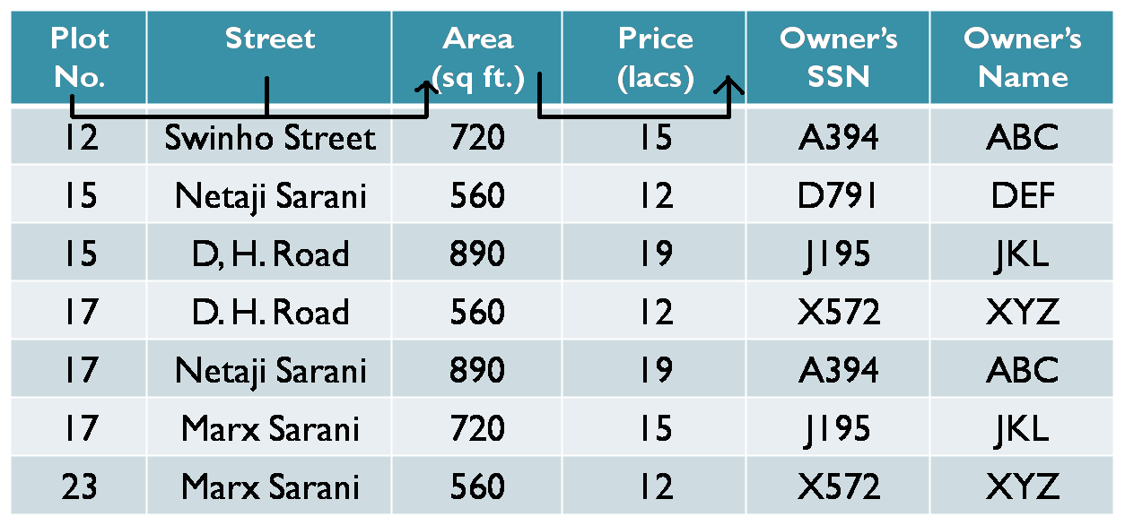
Example of Transitive Dependency

Slide 18
Third Normal Form (3NF)
The table must be in 2NF.
There must not be an transitive dependency.

Slide 19
Relation in 3NF
Plot No. | Street | Area (sq ft.) | Owner’s SSN | Owner’s Name
12 | Swinho Street | 720 | A394 | ABC
15 | Netaji Sarani | 560 | D791 | DEF
15 | D. H. Road | 890 | J195 | JKL
17 | D. H. Road | 560 | X572 | XYZ
17 | Netaji Sarani | 890 | A394 | ABC
17 | Marx Sarani | 720 | J195 | JKL
23 | Marx Sarani | 560 | X572 | XYZ
Area (sq ft.) | Price (lacs)
720 | 15
560 | 12
890 | 19

Slide 20
Boyce-Codd Normal Form (BCNF)
It must be in 3NF.
For every one of its functional dependencies X -› Y , X is a super key, that is, X is either a candidate key or a superset of candidate key.

Slide 21
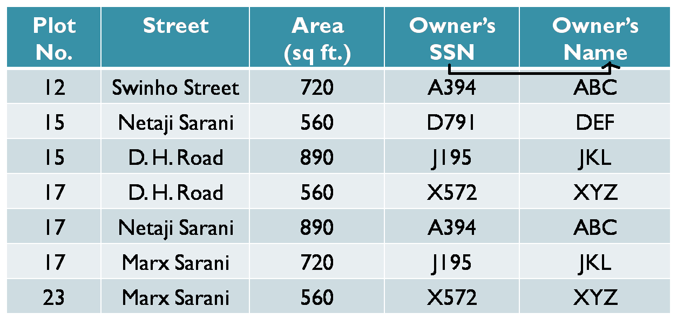
Relation in 3NF but not in BCNF

Slide 22
Relation in BCNF
Plot No. | Street | Area (sq ft.) | Owner’s SSN
12 | Swinho Street | 720 | A394
15 | Netaji Sarani | 560 | D791
15 | D. H. Road | 890 | J195
17 | D. H. Road | 560 | X572
17 | Netaji Sarani | 890 | A394
17 | Marx Sarani | 720 | J195
23 | Marx Sarani | 560 | X572
Owner’s SSN | Owner’s Name
A394 | ABC
D791 | DEF
J195 | JKL
X572 | XYZ

Slide 23
Multivalued Dependency
The multivalued dependency requires that certain tuples be present in a relation. That is for a single value of a particular attribute there will exists more than one values for other attributes.

Slide 24
Example of Multivalued Dependency
Owner’s SSN | Owner’s Name | Phone Number
A394 | ABC | 2448-6843
D791 | DEF | 2234-8356
D791 | DEF | 2345-6789
J195 | JKL | 2678-9876
J195 | JKL | 2567-8929
X592 | XYZ | 2314-7345
X592 | XYZ | 2314-0934

Slide 25
Trivial MVD
A MVD X -» Y in relation R is said to be Trivial either Y ⊆ X or X ∪ Y = R holds.

Slide 26
Fourth Normal Form (4NF)
R is in BCNF.
For every non trivial MVD X -›› Y, X is a super key in R.

Slide 27
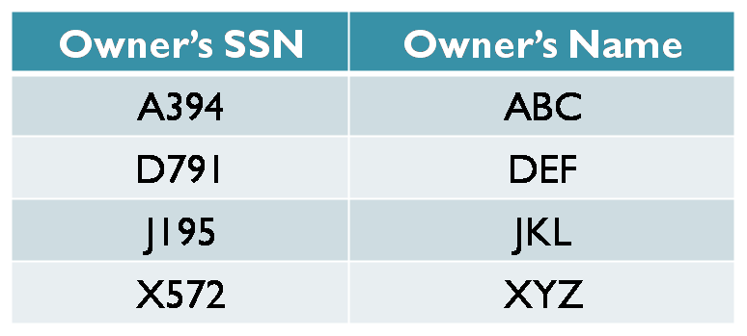
Relation in 4NF
Owner’s SSN | Phone Number
A394 | 2448-6843
D791 | 2234-8356
D791 | 2345-6789
J195 | 2678-9876
J195 | 2567-8929
X572 | 2314-7345
X572 | 2314-0934

Slide 28
Join Dependency
A relation R satisfies join dependency (R₁,R₂, . . . ,R_{n}) if and only if R is equal to the join of R₁,R₂, . . . ,R_{n} where R_{i} are subsets of the set of attributes of R.

Slide 29
Example Join Dependency
Owner’s SSN | Street | Tax (Rs.)
A394 | Swinho Street | 1, 990
A394 | Netaji Sarani | 1, 750
D791 | Netaji Sarani | 1, 830
J195 | D. H. Road | 1, 750
J195 | Marx Sarani | 1, 830
X572 | D. H. Road | 1, 830
X572 | Marx Sarani | 1, 670
Above Relation cannot be decomposed as --
(Owner’s SSN, Street) and (Owner’s SSN, Tax)

Slide 30
Fifth Normal Form (5NF)
(R₁,R₂, ...,R_{n}) is a trivial join-dependency (that is, one of R_{i} is R)
Every R_{i} is a candidate key for R.

Slide 31
Relation in 5NF
Owner’s SSN | Street
A394 | Swinho Street
A394 | Netaji Sarani
D791 | Netaji Sarani
J195 | D. H. Road
J195 | Marx Sarani
X572 | D. H. Road
X572 | Marx Sarani
Owner’s SSN | Tax(Rs.)
A394 | 1,990
A394 | 1,750
D791 | 1,830
J195 | 1,830
J195 | 1,750
X572 | 1,670
X572 | 1,670
Street | Tax(Rs.)
Swinho Street | 1,990
Netaji Sarani | 1,750
D. H. Road | 1,830
Marx Sarani | 1,670

Slide 32
Relational
Database
Normalization
Unnormalized
Database
Remove non-atomic
attributes
Database in 1NF
2. Remove
partial
dependency
Database in 2NF
3. Remove transitive
dependency
Database in 3NF
4. Remove non-key
determinants
4NF & 5NF
Database in
BCNF

Slide 33
Disadvantage of Normalization
Large number of joins, so more complexity

Slide 34
Thank You…

